Slide 1

Manikya Lal Verma Textile & Eng. College
Q.G. - 11
Submitted To
Mrs. Hareeta Malani
(Project Guide, Asst. ECE Department)
Submitted By
Ashish Sahu
Shubham Sharma
Vishal Yadav
Dharmendra Saini
Santosh Yadav

Slide 2
IoT And GSM Based Smart Security System

Slide 3
Introduction
Introduction of Project
Contribution of Individuals
PCB Layouts
Overall View
Describe by Vishal Yadav
Hardware and component placement
Brief description
Describe by Shubham sharma and Dharmendra Saini
Embedded Coding
Brief Description
Described by Ashish Sahu
MATLAB and IOT Interface
Brief Description
Described by Ashish Sahu

Slide 4
Aim of Our Project
The aim of our project is to provide privacy and security to a particular Home or companies from remote locations from a central Server system.
the system allows the home owner or company owner to monitor and control the house security like Whose entered, Door lock or door unlocked, which can be switched on or o via the mobile phone set by sending commands in the form of SMS and also the home owner can receive the appliances status.

Slide 5
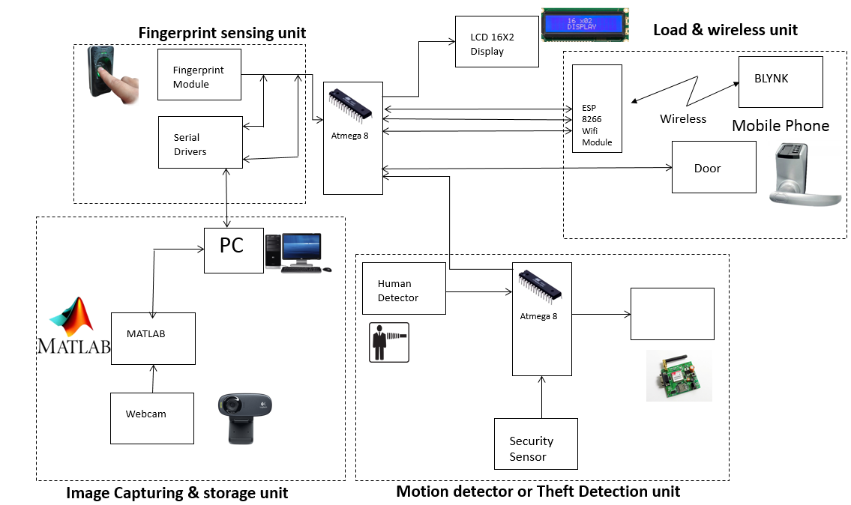
Block Diagram

Slide 6
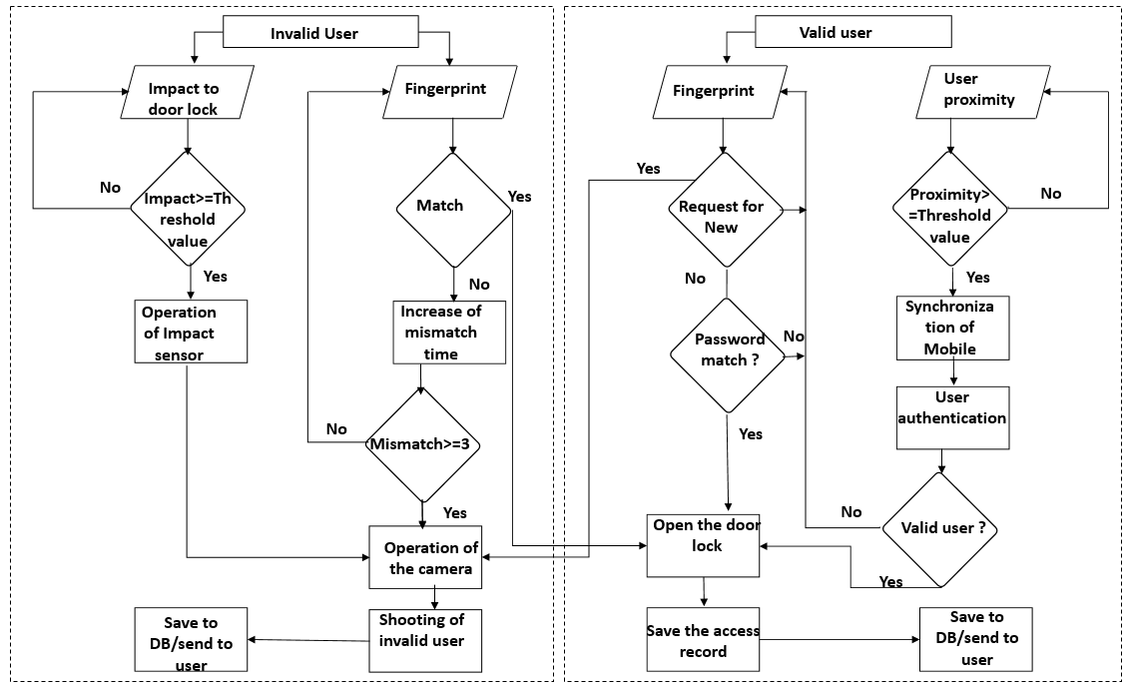
User Enter

Slide 7
First
PCB Layout
Implemented By Vishal Yadav
Second
Hardware and component placement
Implemented By Ashish kumar
Third
MATLAB and IOT Interface
Implemented By Santosh Yadav
Fourth
Implemented By ashish,shubham,dhremandra.
Embedded Coding

Slide 8
PCB Layouts
First Development Board
Second Development Board
Remote and Noise detection Unit

Slide 9
INTERFACING WITH HARDWARE COMPONENT
USE OF HARDWARE COMPONENT.
USE OUSE OF LCD COMPONENT.
F ESP8266 MODULE.
USE OF FINGURE PRINT SENSOR.
USE OF GSM MODULE.
USE OF PROXIMITY SENSOR.
USE OF SOUND MODULE

Slide 10
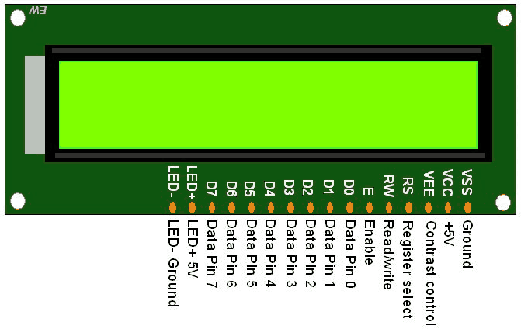
USE OF LCD 16X2

Slide 11
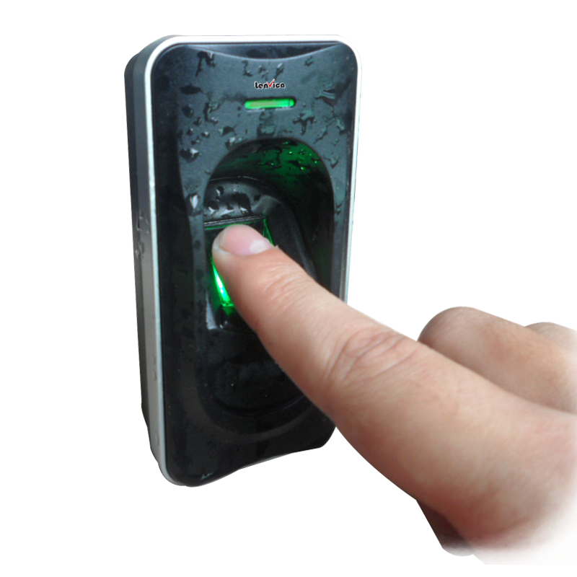
FINGURE PRINT SENSOR

Slide 12
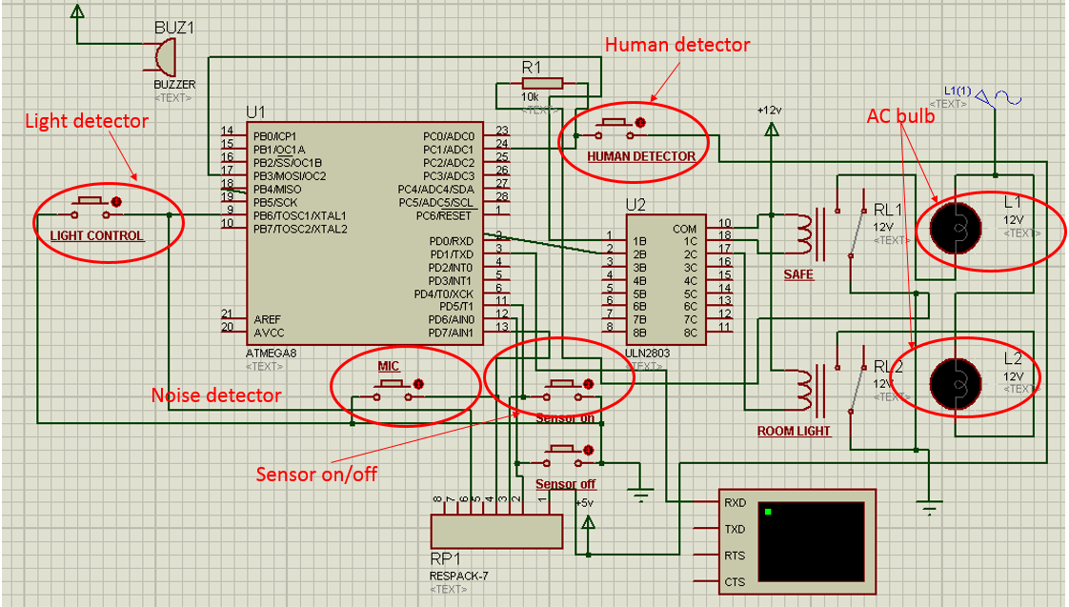
First Development Board Circuit Diagram

Slide 13
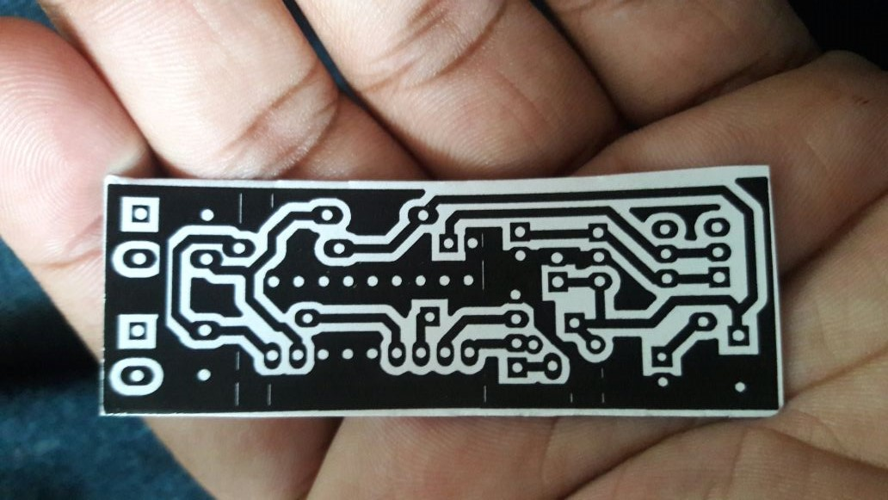
PCB Layout of Transmitter Section

Slide 14
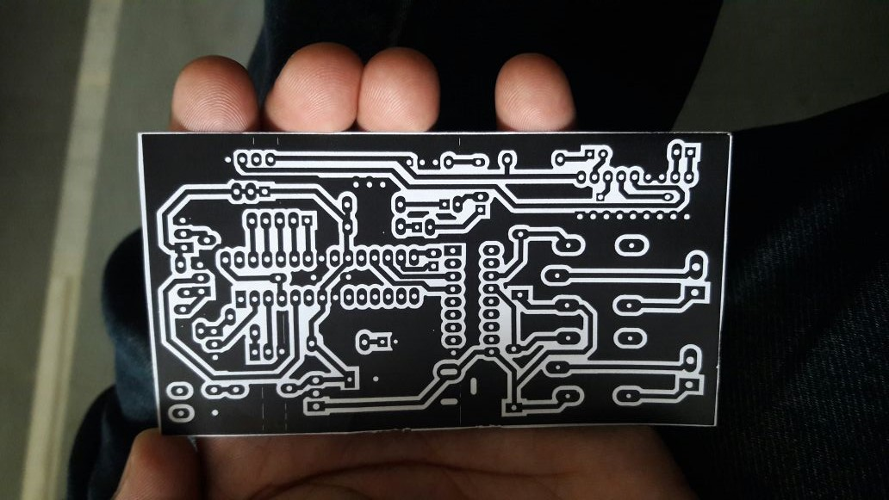
PCB Layout of Atmega 8 Section

Slide 15
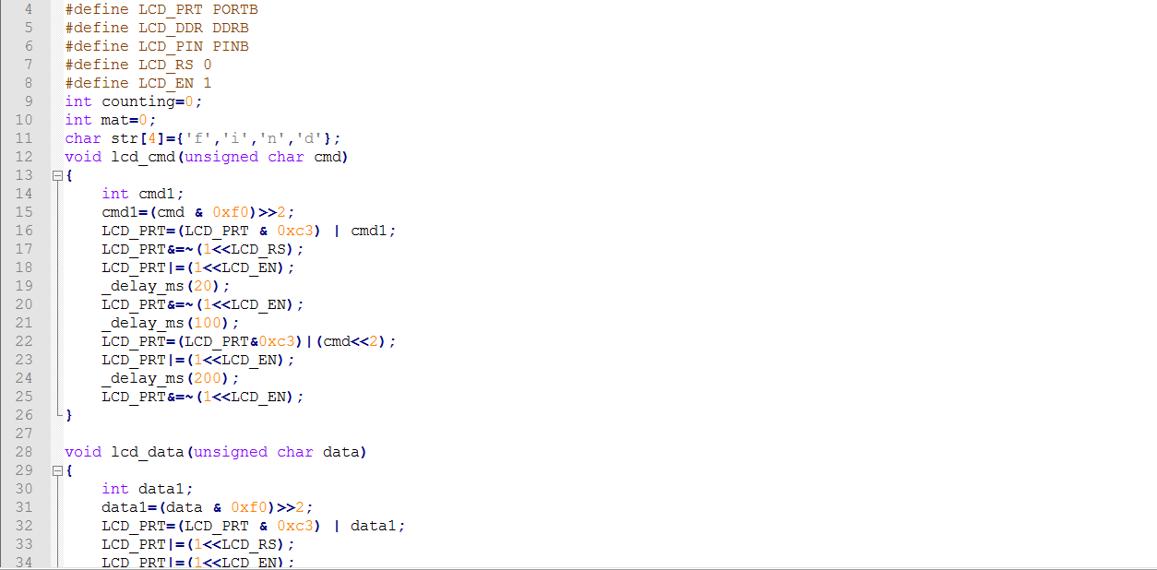
Coding of embedded c

Slide 16
USING OF IOT BY ESP 8266 MODUE
It is used for send the message signal.
It use for sending the data by using sever.
It can also be easily configured as a web server.
It is a wifi module .
These module accepts commands via a simple serial interface.

Slide 17
Motion Detector or Theft Detection Unit
The motion sensor gives digital output which has been used as microcontrollers input. When motion has been detected, motion detector gives logical one to the microcontroller.
As a motion sensor we used PIR sensor which allow you to sense motion, almost always used to detect whether a human has moved in or out of the sensor’s range.
They are often referred to as PIR, ”Passive Infrared”, ”Piezoelectric”, or ”IR motion” sensors.

Slide 18
Algorithm
STEP 1 : START
STEP 2 : FOR each user
STEP 3 : INPUT Action
STEP 4 : SWITCH Action
STEP 5 : CASE “fingerprint”
STEP 6 : IF fingerprint does not match THEN take and send image
STEP 7 : ELSE IF fingerprint is valid THEN open the door
STEP 8 : ELSE IF number of mismatch greater then 3 THEN take and send image
STEP 9 : ELSE go to STEP 2
STEP 10 : CASE “impact”
STEP 11 : Impact Sensor operation
STEP 12 : IF impact value greater then threshold valu THEN camera sensor operation
STEP 13 : ELSE go to STEP 2
STEP 14 : CASE “proximity”
STEP 15 : IF distance greater then threshold value THEN mobile device synchronization
STEP 16 : IF valid user THEN open the door
STEP 17 : ELSE go to STEP 2
STEP 18 : ELSE go to STEP 2
STEP 19 : END

Slide 19
Simulation

Slide 20
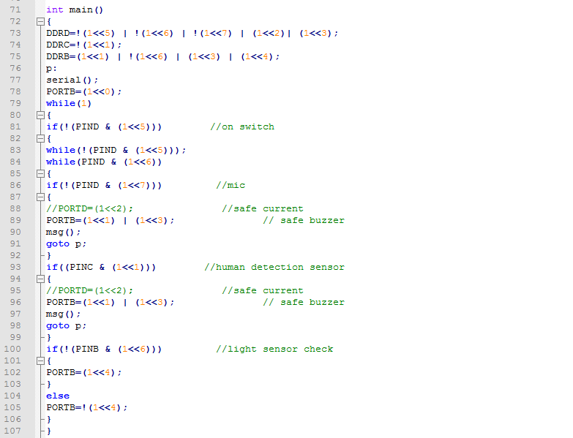
Coding Section

Slide 21
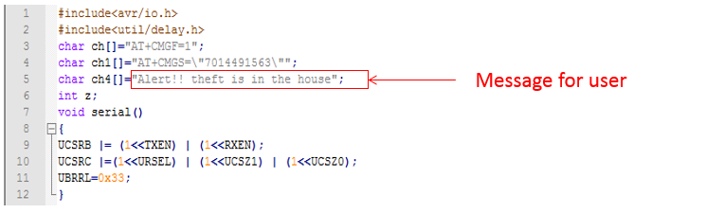
Coding Section for User

Slide 22
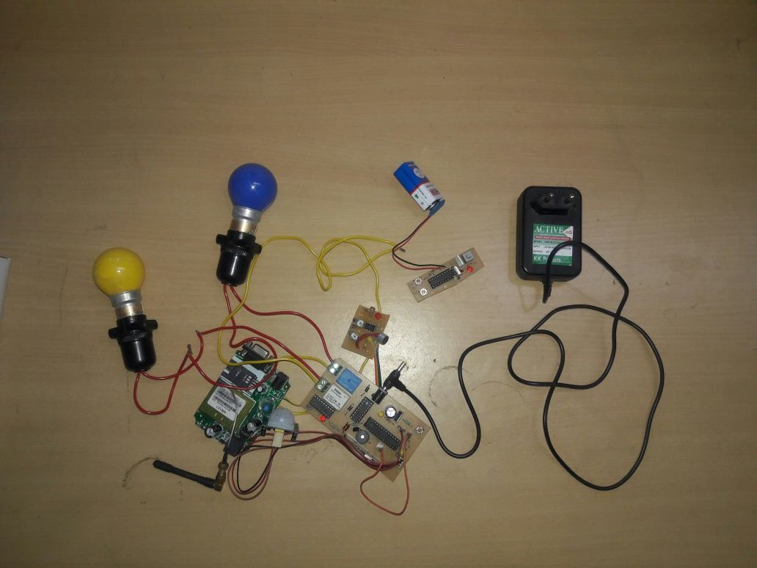
Hardware of Theft Detection Unit

Slide 23
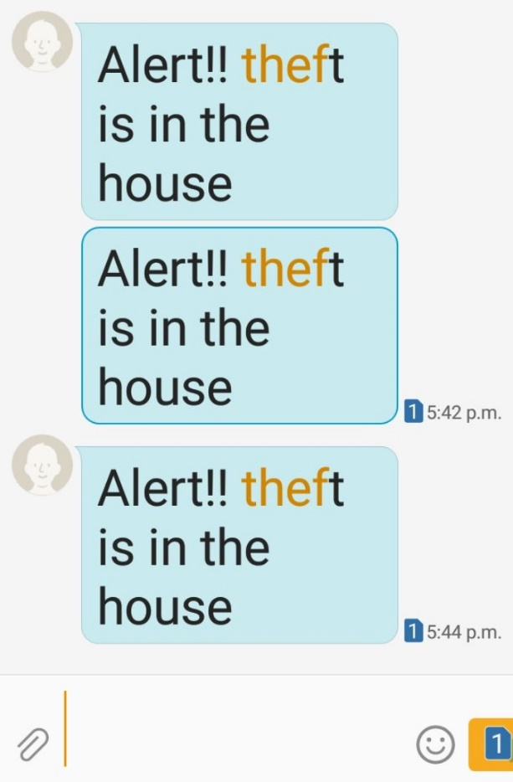
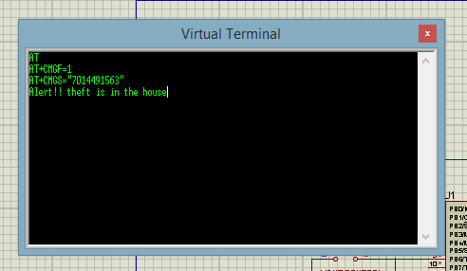
Result
Figure shows the screenshot of the message for the theft detector operation. The user can query all records of comings and goings from the ` Log (Access Record)' menu.

Slide 24
Fingerprint Verification Unit
This unit monitors real time fingerprint verification data from doors. This unit has its setting limitted tryels.
Above this value, the microcontroller sends message to the users mobile phone that the someone tryed to acces door and crossed its limited trial.
We have used RS305 as fingerprint sensor.

Slide 25
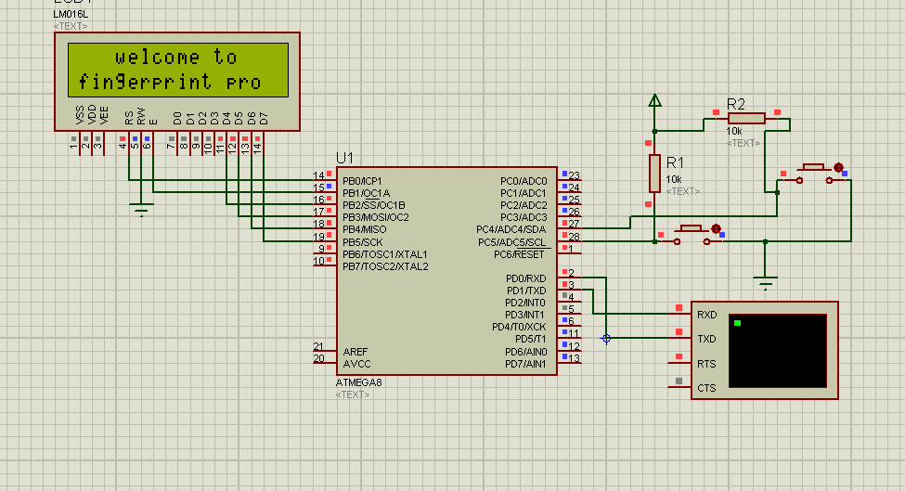
Simulator

Slide 26
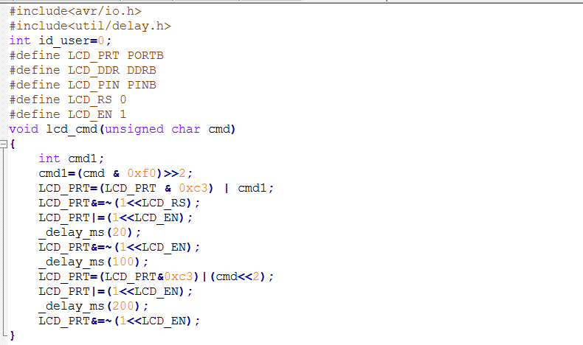
Coding Screenshots of Fingerprint Section
Function for LCD command

Slide 27
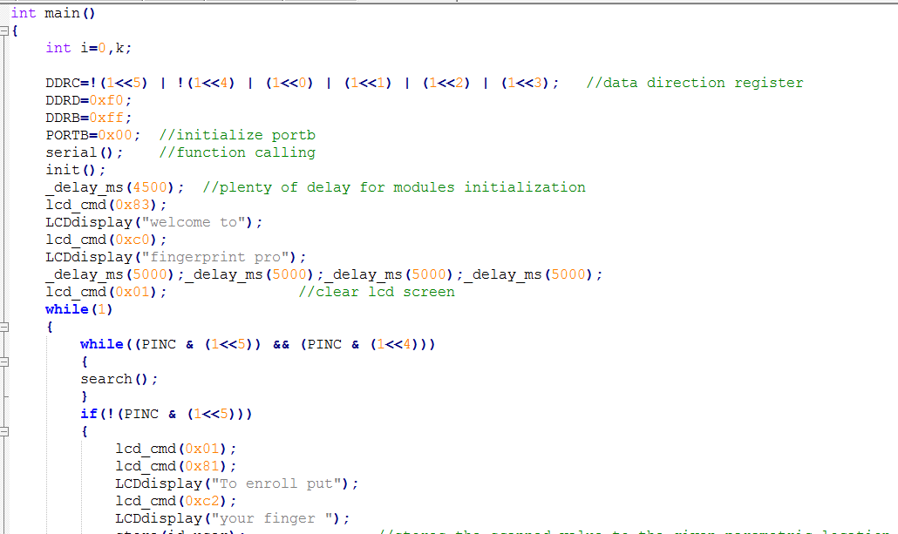
Display message fro LCD
Message for User for enroll

Slide 28
Load and Wireless Unit
Protection of home main door is the important part in security system which done in this system by using electromagnetic lock in conjunction with fingerprint module.
The owner using this biometric for valid user which is display on LCD and if the fingerprint matched is correct then the electromagnetic lock is opened. Otherwise if does not matched, the door will still locked.

Slide 29
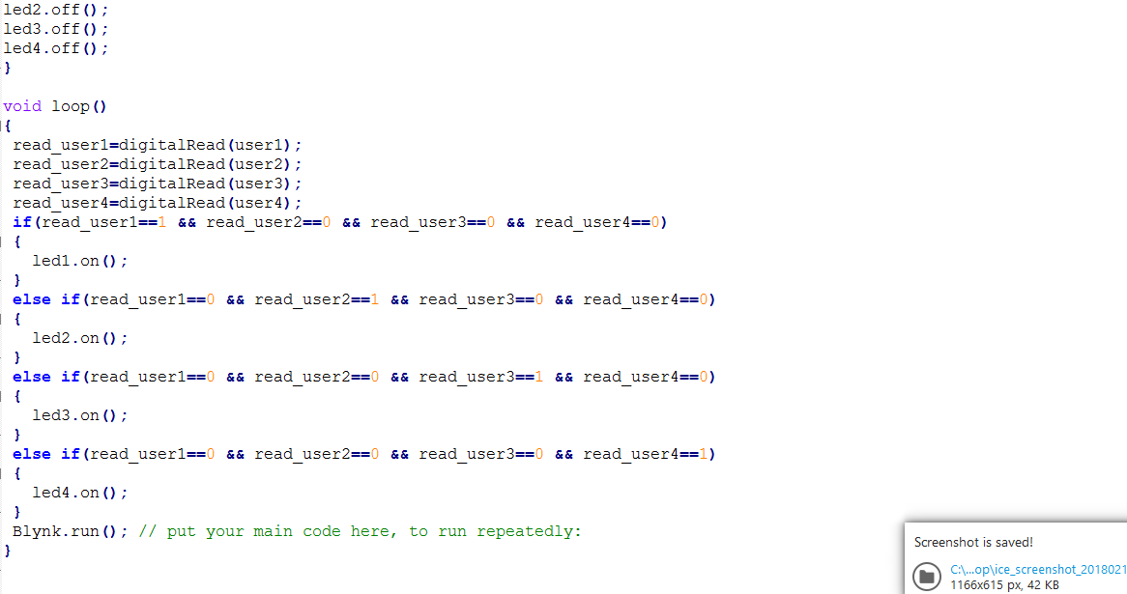

Slide 30
Conclusion
The GSM and IOT based advance security system has been designed and tested with the mobile network.
The user can get alerts anywhere through the GSM technology thus making the system location independent.
The web camera based security system is very easy, user friendly and software has many features.
By installing the web camera at the door site, intruder can be detected and owner can receive a message telling the intruder entry in a home.

Slide 31
MATLAB INTERFACE
Detection
Footage Recording
Image Capturing

Slide 32
Detection Of Invalid User
Fingerprint Section
User Verification
Invalid User Found
USB to TTL
MATLAB

Slide 33
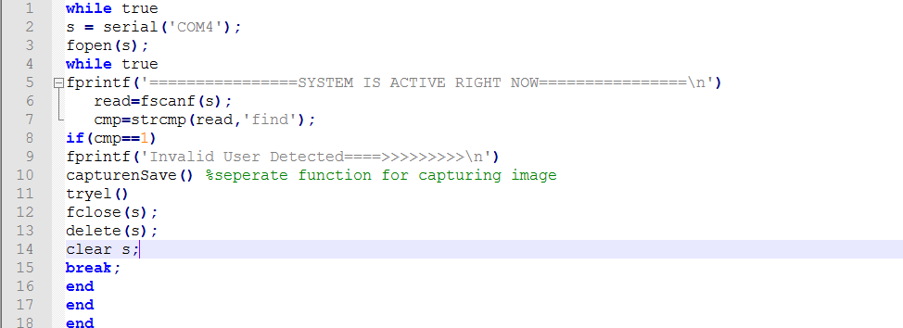
Coding Section of Detection Function

Slide 34
Image Capturing and Storing Unit
Serial Communication
Image captured and stored
Image capturing function activate

Slide 35
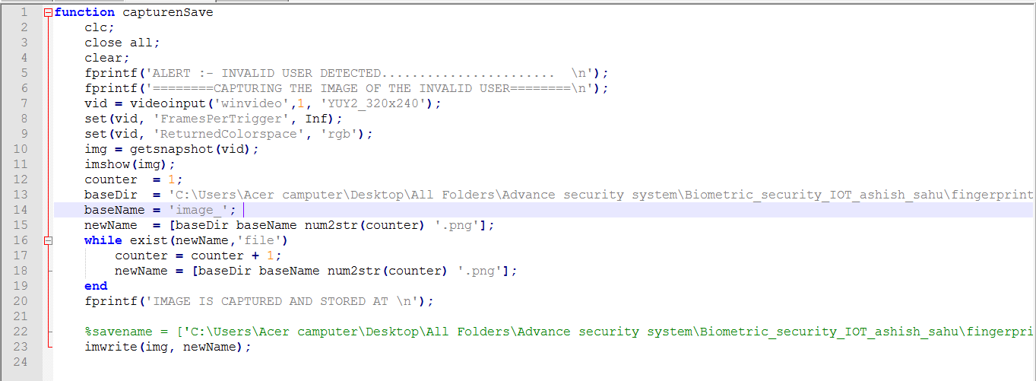
Coding Section of Image Capturing Function

Slide 36
Video Recording Unit
After the image captured Video recording section is activate.
Captured video can be stored and can be use for investigation process.

Slide 37
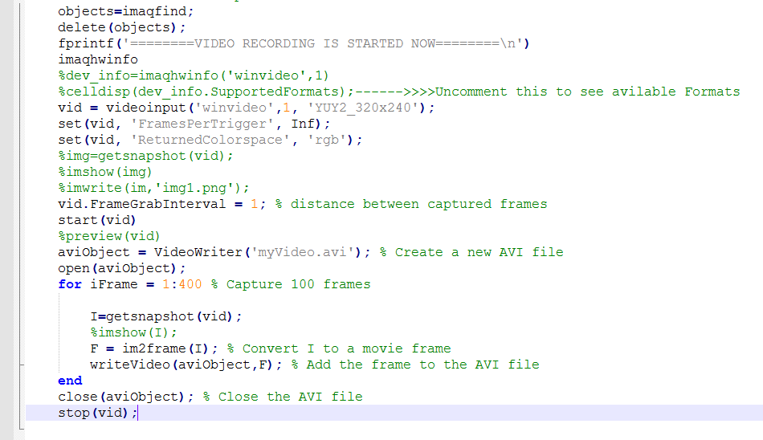
Coding section of Video Recording Unit

Slide 38
IoT Section
Invalid User Entered
Known/Unknown
MATLAB Interface
Image and Video Recorded
Notification to Admin Using Blynk
Full Control of Admin

Slide 39
Coding of IoT Section
Image Captured Using MATLAB
Notification with Blynk App
Known
Unknown
Door Control to Admin
Lock
Unlock

Slide 40
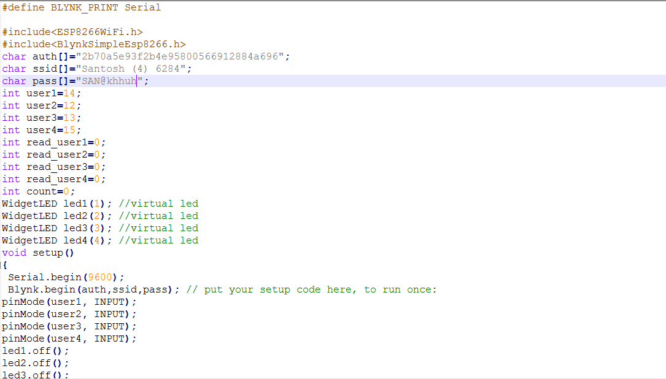
Coding of IoT Section

Slide 41
References
Yanbo Zhao , Zhaohui Ye "A low cost GSM/GPRS based wireless home security system" IEEE Transactions on Consumer Electronics ( Volume: 54, Issue: 2 ),2008.
C. Pyo, H. Gang, N. Kim and H. Bang, \Technology trends and prospects of development of IoT (M2M)," OSIA Standards & Technology Review, vol. 26, no. 2, (2013), pp. 8-17.
Y. Ko, \Study of Policies of Major Countries on Internet of Things and Market Forecast," In ternational Commerce and Information Review, vol. 16, no. 5, (2014),pp. 27-47.
D. Seo, H. Ko and Y. Noh, \Design and Implementation of Digital Door Lock by IoT," KIISE Transactions on Computing Practices (KTCP), vol. 21, no. 3, (2015), pp. 215-222.

Slide 42
Thank You

